Slide 1
Tips on Running a Successful Experiment
Nicholas
Del Grosso
delgrosso@bio.lmu.de

Slide 2
A Successful Experiment Adds to the Existing Body of Knowledge
Has Positive Results
Has Interpretable Results
Has Replicable Results

Slide 3
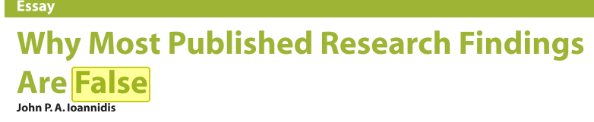
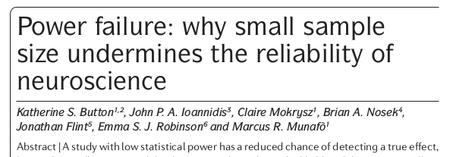


Successful Experiments Rely on Good Practices

Slide 4
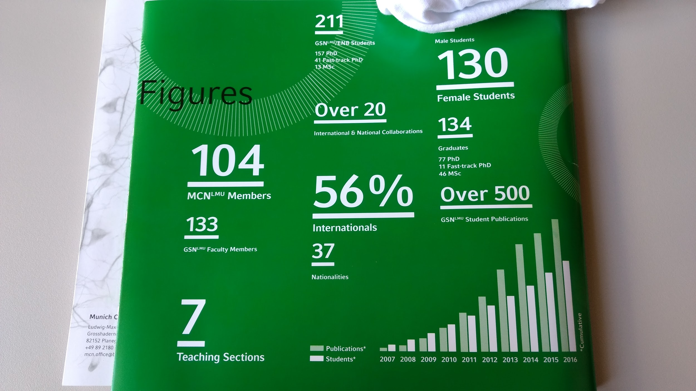

Slide 6
If You Only Remember One Thing, Remember:
Garbage In, Garbage Out.
Notes:
Do Your Research
Have Clear Goals From the Start.
Get Good Collaborators.
Respect Your Humanity.
Communicate.
Keep Your Projects Short.
Make Your Experiments Simple.
Collect Enough Data.
Make Your Analysis Reflect Your Experiment.

Slide 7
Understand the Problem Before Building a Solution
Spend as Much Time As You Can Reading
Do Not Base Your Research on One Paper
Use Literature Databases To Perform Exhaustive Searches
Keep Up-to-Date with Email Alerts
Notes:
Spend as Much Time As You Can Reading
Research Trends Come in Waves: Read Old and New Work
Your Problem May be New in Your Field, and Old in Another. Read from Many Fields
Do Not Base Your Research on One Paper
Google is Not Your Friend: Use Literature Database Search Engines like the Web of Science

Slide 8
See the Results Before You Start:
Designing an Experiment
Identify a Clear, Specific Research Question
Make a Clear Hypothesis that is:
  Specific to Your Research Question
  Observable in an Experiment
  Falsifiable
Design an Experiment whose Data can be Specific to Your Hypothesis.

Slide 9
If You Only Remember One Thing, Remember:
Garbage In, Garbage Out.
Notes:
Do Your Research
Have Clear Goals From the Start.
Get Good Collaborators.
Respect Your Humanity.
Communicate.
Keep Your Projects Short.
Make Your Experiments Simple.
Collect Enough Data.
Make Your Analysis Reflect Your Experiment.

Slide 10
If You Only Remember Two Things, Remember:
Garbage In, Garbage Out.
Experiments Have a Clearly-Defined Endpoint.
Notes:
Do Your Research
Have Clear Goals From the Start.
Get Good Collaborators.
Respect Your Humanity.
Communicate.
Keep Your Projects Short.
Make Your Experiments Simple.
Collect Enough Data.
Make Your Analysis Reflect Your Experiment.

Slide 11
If You Can’t Do the Project,You Can’t Do the Project:
Plan It Out
Make a Realistic Schedule
  Remember: New == Expensive
  Don’t Book Yourself 100%
  Schedule “Catch Up,” “Maintenance,” and “Review” Days
  Review Your Plans with all Collaborators and Supervisors
  Keep the Project Short
Use Pilot Experiments to Identify and Estimate “Unknown Unknowns”
Notes:
Make a Schedule
...and Triple It
Give Yourself Time to Do a Good Job
Do Not Schedule Yourself 100%
New == Expensive: Enumerate Your Resources
People
Equipment
Money
Keep it Simple
Remove anything that’s not essential
Consult with Experts:
Do it Early
Do it Often

Slide 12
If You Only Remember Two Things, Remember:
Garbage In, Garbage Out.
Experiments Have a Clearly-Defined Endpoint.
Notes:
Do Your Research
Have Clear Goals From the Start.
Get Good Collaborators.
Respect Your Humanity.
Communicate.
Keep Your Projects Short.
Make Your Experiments Simple.
Collect Enough Data.
Make Your Analysis Reflect Your Experiment.

Slide 13
If You Only Remember Three Things, Remember:
Garbage In, Garbage Out.
Experiments Have a Clearly-Defined Endpoint.
Insufficient Data == Insufficient Knowledge.
Notes:
Do Your Research
Have Clear Goals From the Start.
Get Good Collaborators.
Respect Your Humanity.
Communicate.
Keep Your Projects Short.
Make Your Experiments Simple.
Collect Enough Data.
Make Your Analysis Reflect Your Experiment.

Slide 14
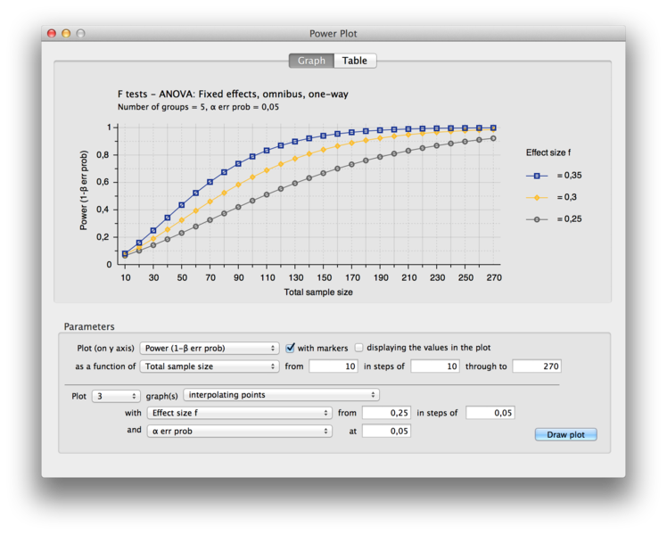
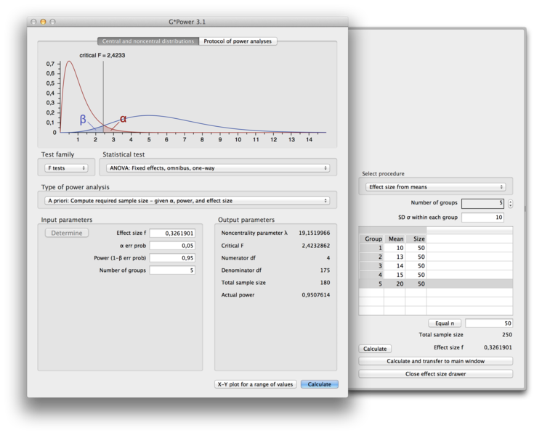
You Need More Data Than You Think:
Estimate Needed Sample Size with Power Analyses

Slide 15
You Need More Data Than You Think:
Experiments are Complex, Data is Not Ideal
Remember That You Need More Data, the More...
Complex The Subjects’ Behavior
Noisy your Recordings
Experimental Parameters You Have
Things You Measure
Analyses You Plan to Do
Convincing Your Data Must Look
Notes:
Use Well-Established, Simple Protocols for Subject Training and Data Collection
Simplify Your Experiment:
Use a Simple Experimental Design
Don’t Double Dip: One Experiment, One Question
Reduce Your Parameter Space
Do A-Priori Power Analysis to be sure Your Design is Reasonable
Keep Backups and schedule Maintenance Days for all Equipment
Present your Design to Experts and Consult with them for Improvements
Be Consistent and Trust Your Design

Slide 16
You Need More Data Than You Think:
Data Gets Lost in the Experimental Pipeline
Uncollected Data is Lost Data
Bad Data is Lost Data
Sick Days
Equipment Failures
Animal Training Delays
Subject Attrition
Undocumented Sessions
Equipment Loss or Failure
Subject Failures
Artifacts in Your Sensor Recordings
Analysis-Specific Outliers
Difficult-to-Process Data Formats
Insufficient Data Amounts for Analysis

Slide 17
If You Only Remember Three Things, Remember:
Garbage In, Garbage Out.
Experiments Have a Clearly-Defined Endpoint.
Insufficient Data == Insufficient Knowledge.
Notes:
Do Your Research
Have Clear Goals From the Start.
Get Good Collaborators.
Respect Your Humanity.
Communicate.
Keep Your Projects Short.
Make Your Experiments Simple.
Collect Enough Data.
Make Your Analysis Reflect Your Experiment.

Slide 18
If You Only Remember Four Things, Remember:
Garbage In, Garbage Out.
Experiments Have a Clearly-Defined Endpoint.
Insufficient Data == Insufficient Knowledge.
Your Analysis is Part of Your Experiment.
Notes:
Do Your Research
Have Clear Goals From the Start.
Get Good Collaborators.
Respect Your Humanity.
Communicate.
Keep Your Projects Short.
Make Your Experiments Simple.
Collect Enough Data.
Make Your Analysis Reflect Your Experiment.

Slide 19
Data Analysis
Write High-Quality Code
Look for Clear Results
Keep Your Code Simple
Keep Your Data Labeled
Share Your Code
Visualize Early, Visualize Often
Always Label Your Axes
Prioritize Your Analyses
Staring at that Graph Longer won’t Make the Noise Disappear
If You Got Lucky, You Didn’t Get Lucky.
Pursue Serendipitous Findings with Further Experiments

Slide 20
If You Only Remember Four Things, Remember:
Garbage In, Garbage Out.
Experiments Have a Clearly-Defined Endpoint.
Insufficient Data == Insufficient Knowledge.
Your Analysis is Part of Your Experiment.
Notes:
Do Your Research
Have Clear Goals From the Start.
Get Good Collaborators.
Respect Your Humanity.
Communicate.
Keep Your Projects Short.
Make Your Experiments Simple.
Collect Enough Data.
Make Your Analysis Reflect Your Experiment.

Slide 21
If You Only Remember Five Things, Remember:
Garbage In, Garbage Out.
Experiments Have a Clearly-Defined Endpoint.
Insufficient Data == Insufficient Knowledge.
Your Analysis is Part of Your Experiment.
Science is a Group Effort.
Notes:
Do Your Research
Have Clear Goals From the Start.
Get Good Collaborators.
Respect Your Humanity.
Communicate.
Keep Your Projects Short.
Make Your Experiments Simple.
Collect Enough Data.
Make Your Analysis Reflect Your Experiment.

Slide 22
“If I have seen further, it is by standing on the shoulders of giants.“
- Isaac Newton, 1675

Slide 23
Tips on Running a Successful Experiment
Nicholas
Del Grosso
delgrosso@bio.lmu.de

